Slide 1
INFORMATION SYSTEMS IN GLOBAL BUSINESS TODAY

Slide 2
CHAPTER 1: INFORMATION IN BUSINESS SYSTEMS TODAY
The Role of Information Systems in Business Today
How information systems are transforming business
  Increase in wireless technology use, Web sites
  Increased business use of Web 2.0 technologies
  Cloud computing, mobile digital platform allow more distributed work, decision-making, and collaboration
Globalization opportunities
  Internet has drastically reduced costs of operating on global scale
  Presents both challenges and opportunities
© Pearson Education 2012
Notes:
New federal security and accounting laws that require companies to store e-mail for 5 years have spurred the growth of digital information, which is increasing at a rate of 5 exabytes annually. Students may be surprised to learn that 5 exabytes of data is equivalent to 37,000 Libraries of Congress. Ask the students to think about what difference it makes to the world economy, or the U.S. economy, if global operations become much less expensive? What are the challenges to American suppliers of goods and services, and to labor?

Slide 3
CHAPTER 1: INFORMATION IN BUSINESS SYSTEMS TODAY
The Role of Information Systems in Business Today
In the emerging, fully digital firm
  Significant business relationships are digitally enabled and mediated
  Core business processes are accomplished through digital networks
  Key corporate assets are managed digitally
Digital firms offer greater flexibility in organization and management
  Time shifting, space shifting
© Pearson Education 2012
Notes:
Time shifting and space shifting are connected to globalization. You could ask students to explain why a digital firm is more likely to benefit from globalization than a traditional firm. One answer is that by allowing business to be conducted at any time (time shifting) and any place (space shifting), digital firms are ideally suited for global operations which take place in remote locations and very different time zones.

Slide 4
CHAPTER 1: INFORMATION IN BUSINESS SYSTEMS TODAY
The Role of Information Systems in Business Today
Growing interdependence between ability to use information technology and ability to implement corporate strategies and achieve corporate goals
Business firms invest heavily in information systems to achieve six strategic business objectives:
  Operational excellence
  New products, services, and business models
  Customer and supplier intimacy
  Improved decision making
  Competitive advantage
  Survival
© Pearson Education 2012
Notes:
In the Ponsse opening case, the UPS Interactive Session later in the chapter, and with many of the Interactive Sessions and opening cases in the book, it will be useful to ask students to explain how various information systems succeeded or failed in achieving the six strategic business objectives. For example, in the Ponsse case, information systems helped the company communicate more effectively with workers and clients and offer new services. You might ask the students to think about some other business objectives and think about how IT might help firms achieve them. For instance, speed to market is very important to firms introducing new products. How can IT help achieve that objective?

Slide 5
CHAPTER 1: INFORMATION IN BUSINESS SYSTEMS TODAY
The Role of Information Systems in Business Today
Operational excellence:
  Improvement of efficiency to attain higher profitability
  Information systems, technology an important tool in achieving greater efficiency and productivity
  Walmart’s RetailLink system links suppliers to stores for superior replenishment system
© Pearson Education 2012
Notes:
Walmart is the most efficient retailer in the industry and exemplifies operational excellence. You could ask students to name other businesses that they believe to exhibit a high level of operational excellence. Do customers perceive operational excellence? Does it make a difference for customer purchasing? What Web sites strike students as really excellent in terms of customer service? If you have a podium computer, you might want to visit the Walmart site and the Amazon site to compare them in terms of ease of use.

Slide 6
CHAPTER 1: INFORMATION IN BUSINESS SYSTEMS TODAY
The Role of Information Systems in Business Today
New products, services, and business models:
  Business model: describes how company produces, delivers, and sells product or service to create wealth
  Information systems and technology a major enabling tool for new products, services, business models
    Examples: Apple’s iPod, iTunes, iPhone, iPad, Google’s Android OS, and Netflix
© Pearson Education 2012
Notes:
You could ask students to name other new products or business models that they’ve encountered and how they might relate to new information systems or new technology. One way to encourage participation is ask students to help you list on the blackboard some really interesting recent digital product innovations. Discussing “green technologies” like wind, solar, and hybrid vehicles is always fun. In this context, what role will IT be playing in the development of these technologies?

Slide 7
CHAPTER 1: INFORMATION IN BUSINESS SYSTEMS TODAY
The Role of Information Systems in Business Today
Customer and supplier intimacy:
  Serving customers well leads to customers returning, which raises revenues and profits
    Example: High-end hotels that use computers to track customer preferences and use to monitor and customize environment
  Intimacy with suppliers allows them to provide vital inputs, which lowers costs
    Example: J.C.Penney’s information system which links sales records to contract manufacturer
© Pearson Education 2012
Notes:
You could ask students what types of companies might rely more on customer and supplier intimacy than others and which companies they feel have served them exceptionally well. Ask the students to identify online sites that achieve a high degree of customer intimacy. Sites to visit would include Netflix, Amazon, and other sites which have recommender systems to suggest purchase ideas to consumers.

Slide 8
CHAPTER 1: INFORMATION IN BUSINESS SYSTEMS TODAY
The Role of Information Systems in Business Today
Improved decision making
  Without accurate information:
    Managers must use forecasts, best guesses, luck
    Leads to:
      Overproduction, underproduction of goods and services
      Misallocation of resources
      Poor response times
    Poor outcomes raise costs, lose customers
  Example: Verizon’s Web-based digital dashboard to provide managers with real-time data on customer complaints, network performance, line outages, etc.
© Pearson Education 2012
Notes:
You could ask students if they have ever been recipients of exceptional service from a company made possible by improved decision-making and whether or not information systems contributed to that level of service. For example, perhaps they had a power outage and it took a very short (or very long) time for the utility company to correct the error.

Slide 9
CHAPTER 1: INFORMATION IN BUSINESS SYSTEMS TODAY
The Role of Information Systems in Business Today
Operational excellence:
  Improvement of efficiency to attain higher profitability
New products, services, and business models:
  Enabled by technology
Customer and supplier intimacy:
  Serving customers raises revenues and profits
  Better communication with suppliers lowers costs
Improved decision making
  More accurate data leads to better decisions
© Pearson Education 2012
Notes:
This slide is a recap of the previous four slides. You might ask students which business objective they believe to be most critical to the success of a business, or whether they all carry equal weight.

Slide 10
CHAPTER 1: INFORMATION IN BUSINESS SYSTEMS TODAY
The Role of Information Systems in Business Today
Competitive advantage
  Delivering better performance
  Charging less for superior products
  Responding to customers and suppliers in real time
  Examples: Apple, Walmart, UPS
© Pearson Education 2012
Notes:
Emphasize that achieving any of the previous four business objectives represents the achievement of a competitive advantage as well.

Slide 11
CHAPTER 1: INFORMATION IN BUSINESS SYSTEMS TODAY
The Role of Information Systems in Business Today
Survival
  Information technologies as necessity of business
  May be:
    Industry-level changes, e.g. Citibank’s introduction of ATMs
    Governmental regulations requiring record-keeping
      Examples: Toxic Substances Control Act, Sarbanes-Oxley Act
© Pearson Education 2012
Notes:
Ask students if they can name any examples of companies that failed to survive due to unwillingness or inability to update their information systems. The Sarbanes-Oxley Act requires that public firms keep all data, including e-mail, on record for 5 years. You could ask students if they appreciate why information systems would be useful towards meeting the standards imposed by this legislation.

Slide 12
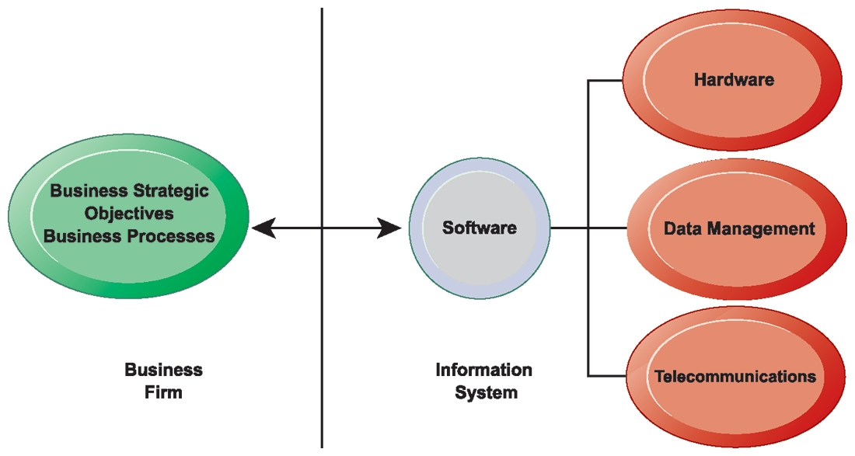
CHAPTER 1: INFORMATION IN BUSINESS SYSTEMS TODAY
The Role of Information Systems in Business Today
The Interdependence Between Organizations and Information Technology
Figure 1.2
In contemporary systems there is a growing interdependence between a firm’s information systems and its business capabilities. Changes in strategy, rules, and business processes increasingly require changes in hardware, software, databases, and telecommunications. Often, what the organization would like to do depends on what its systems will permit it to do.
© Pearson Education 2012
Notes:
The basic point of this graphic is that in order to achieve its business objectives, a firm will need a significant investment in IT. Going the other direction (from right to left), having a significant IT platform can lead to changes in business objectives and strategies.
Emphasize the two-way nature of this relationship. Businesses rely on information systems to help them achieve their goals; a business without adequate information systems will inevitably fall short. But information systems are also products of the businesses that use them. Businesses shape their information systems and information systems shape businesses.

Slide 13
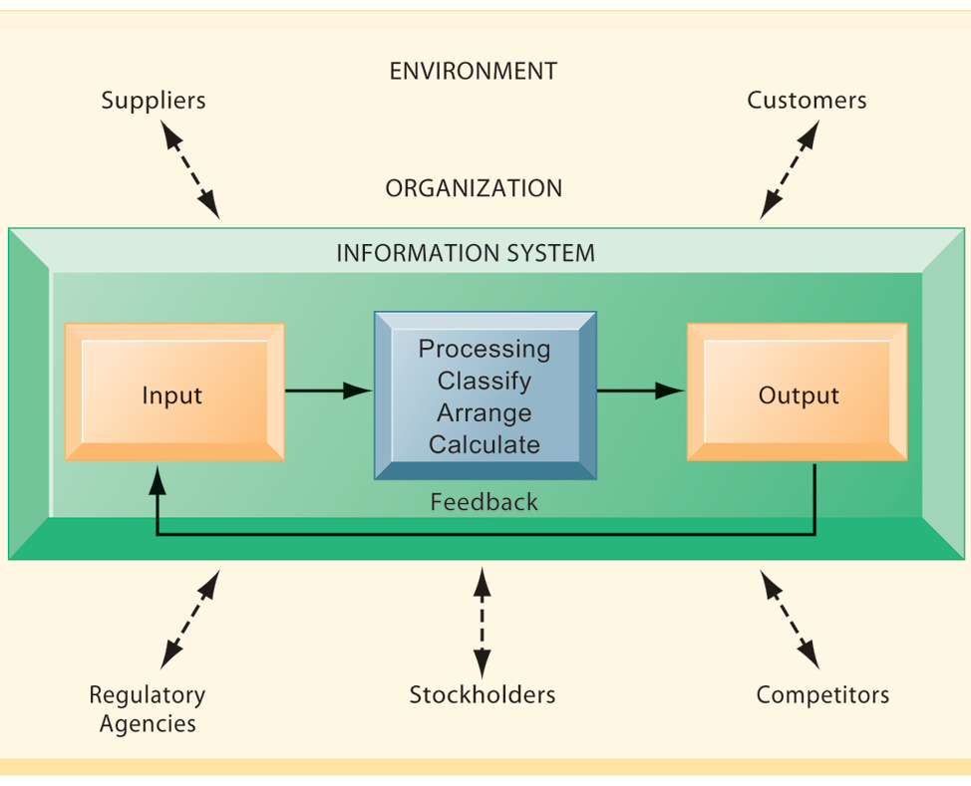
CHAPTER 1: INFORMATION IN BUSINESS SYSTEMS TODAY
Perspectives on Information Systems
Functions of an Information System
An information system contains information about an organization and its surrounding environment. Three basic activities—input, processing, and output—produce the information organizations need. Feedback is output returned to appropriate people or activities in the organization to evaluate and refine the input. Environmental actors, such as customers, suppliers, competitors, stockholders, and regulatory agencies, interact with the organization and its information systems.
Figure 1.4
© Pearson Education 2012
Notes:
The point of this diagram is first of all to highlight the three basic activities of information systems, so that students can understand what an information system is doing at its most fundamental level. But the diagram also puts information systems into the context of organizations (firms), and then puts the firm into its respective environment composed of shareholders, higher level authorities (government), competitors, suppliers and customers. Suddenly students should see that information systems play a central role mediating and interacting with all these players. Hence, systems play a key role in the operations and survival of the firm.
You could also explain this diagram by relating it back to the opening case, as the book does. The two types of input into the Synergy system are manually entered data as well as video. The system processes that data and creates the output, video and statistics about specific types of players and plays.

Slide 14
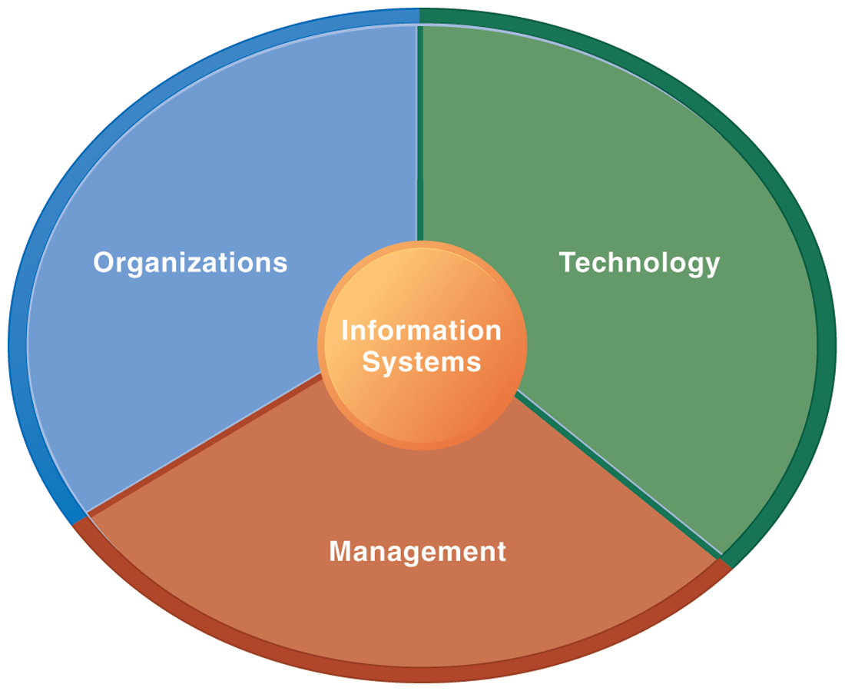
CHAPTER 1: INFORMATION IN BUSINESS SYSTEMS TODAY
Perspectives on Information Systems
Information Systems Are More Than Computers
Using information systems effectively requires an understanding of the organization, management, and information technology shaping the systems. An information system creates value for the firm as an organizational and management solution to challenges posed by the environment.
Figure 1.5
© Pearson Education 2012
Notes:
These three themes (management, organizations, and technology) will reappear throughout the book. Understanding the interaction between these factors and information systems is known as information system literacy. Knowing how to optimize the relationship between technology, organizations, and management is the purpose of this book and course.

Slide 15
CHAPTER 1: INFORMATION IN BUSINESS SYSTEMS TODAY
Perspectives on Information Systems
Organizational dimension of information systems
  Hierarchy of authority, responsibility
    Senior management
    Middle management
    Operational management
    Knowledge workers
    Data workers
    Production or service workers
© Pearson Education 2012
Notes:
Pages 50 and 51 in the text provides more specific details on each level of this hierarchy. You can ask students to talk about an organization where they currently work, or have worked in the past. What was their contact with senior management, middle management, and operational (supervisory) management? Many younger students will have had little or no contact with senior and middle management. Older students most likely will have experience. You might need to provide more description about exactly what senior managers do for the firm (and middle managers).

Slide 16
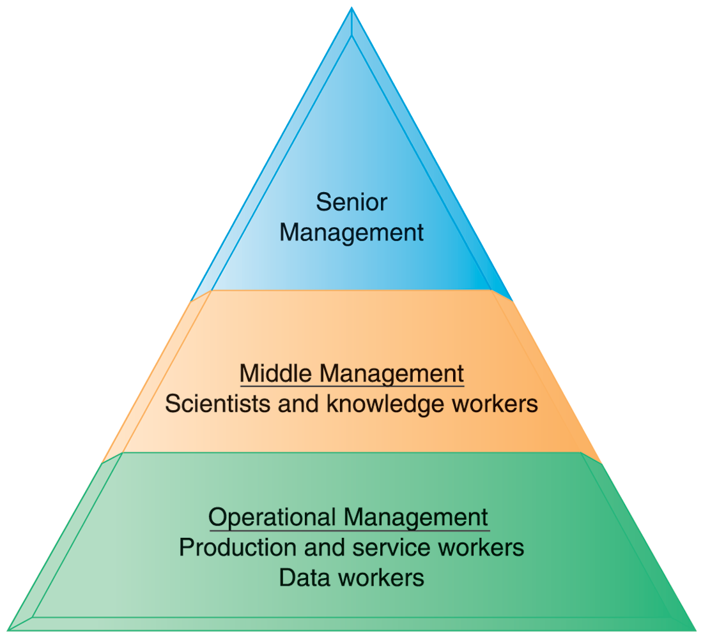
CHAPTER 1: INFORMATION IN BUSINESS SYSTEMS TODAY
Perspectives on Information Systems
Levels in a Firm
Business organizations are hierarchies consisting of three principal levels: senior management, middle management, and operational management. Information systems serve each of these levels. Scientists and knowledge workers often work with middle management.
Figure 1.6
© Pearson Education 2012
Notes:
Ask students to think about how information systems would factor into the day-to-day jobs of each of the three types of workers in the pyramid.

Slide 17
CHAPTER 1: INFORMATION IN BUSINESS SYSTEMS TODAY
Perspectives on Information Systems
Organizational dimension of information systems (cont.)
  Separation of business functions
    Sales and marketing
    Human resources
    Finance and accounting
    Manufacturing and production
  Unique business processes
  Unique business culture
  Organizational politics
© Pearson Education 2012
Notes:
The point of this slide is to let students know there are many organizational factors that will shape information systems. A common observation is that “Every business is different.” Does this mean every business will have different information systems? Every business has its unique culture, and politics. Systems reflect these business cultures.
For an example of how information systems shed light on a firm’s unique business processes and culture, you might describe the UPS Interactive Session later in the chapter. The company’s package tracking systems exemplify their commitment to customer service and putting the customer first.

Slide 18
CHAPTER 1: INFORMATION IN BUSINESS SYSTEMS TODAY
Perspectives on Information Systems
Management dimension of information systems
  Managers set organizational strategy for responding to business challenges
  In addition, managers must act creatively:
    Creation of new products and services
    Occasionally re-creating the organization
© Pearson Education 2012
Notes:
How might information systems assist managers in the development of new products and services? What is meant by re-creating the organization? Why do organizations need to be continually re-created? The answer is that they quickly become obsolete unless they continue to change. Ask students to help you list some organizations that have recently failed, or are about to fail.

Slide 19
CHAPTER 1: INFORMATION IN BUSINESS SYSTEMS TODAY
Perspectives on Information Systems
Technology dimension of information systems
  Computer hardware and software
  Data management technology
  Networking and telecommunications technology
    Networks, the Internet, intranets and extranets, World Wide Web
  IT infrastructure: provides platform that system is built on
© Pearson Education 2012
Notes:
Information technology is at the heart of information systems. While organization and management are important too, it’s the technology that enables the systems and the organizations and managers who use the technology.
The distinction between the Internet and intranets & extranets has to do with their scope. Intranets are private networks used by corporations and extranets are similar except that they are directed at external users (like customers and suppliers). In contrast, the Internet connects millions of different networks across the globe. Students may not immediately understand this distinction.

Slide 20
CHAPTER 1: INFORMATION IN BUSINESS SYSTEMS TODAY
Perspectives on Information Systems
Business perspective on information systems:
  Information system is instrument for creating value
  Investments in information technology will result in superior returns:
    Productivity increases
    Revenue increases
    Superior long-term strategic positioning
© Pearson Education 2012
Notes:
You could ask students to consider how this view of information systems might contrast with the sociotechnical view or other views. You could also ask them to consider the circumstances under which information systems might not result in increased productivity and revenue.

Slide 21
CHAPTER 1: INFORMATION IN BUSINESS SYSTEMS TODAY
Perspectives on Information Systems
Business information value chain
  Raw data acquired and transformed through stages that add value to that information
  Value of information system determined in part by extent to which it leads to better decisions, greater efficiency, and higher profits
Business perspective:
  Calls attention to organizational and managerial nature of information systems
© Pearson Education 2012
Notes:
During this and the next slide, emphasize that the end result of the business information value chain will always be profitability.
Questions for students: What aspects of the business perspective might be lacking? Are there other perspectives that might provide a different picture? (sociotechnical)

Slide 22
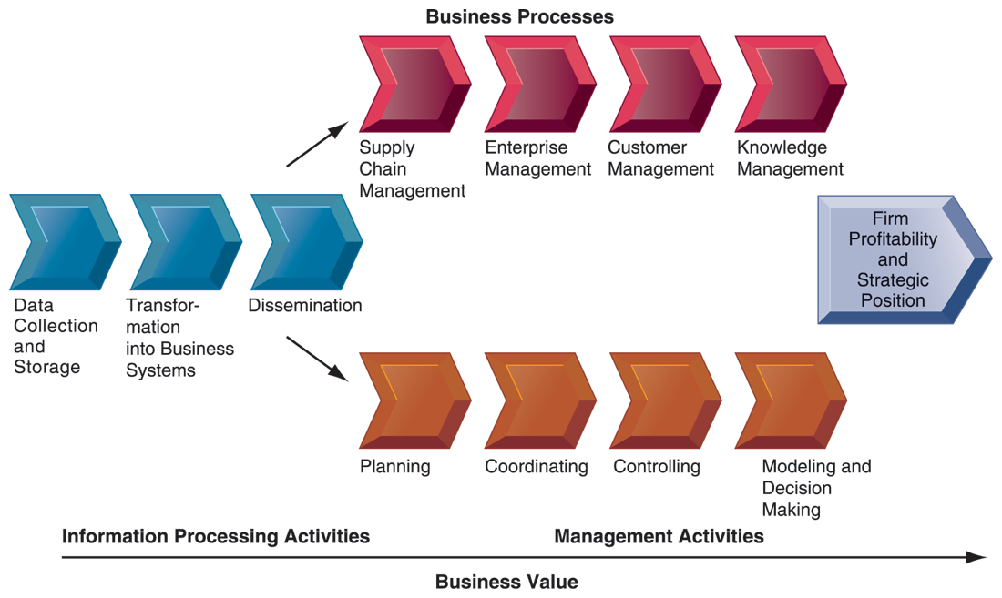
CHAPTER 1: INFORMATION IN BUSINESS SYSTEMS TODAY
Perspectives on Information Systems
The Business Information Value Chain
Figure 1-7
From a business perspective, information systems are part of a series of value-adding activities for acquiring, transforming, and distributing information that managers can use to improve decision making, enhance organizational performance, and, ultimately, increase firm profitability.
© Pearson Education 2012
Notes:
The information value chain is one way to visualize the relationship between information activities, business processes, and management activities. You could also ask students if they could imagine any reason to create an information system besides profitability or strategic positioning (it’s not likely that they will think of one, which will prove the point). One reason to create a system that is not primarily profit oriented is to meet the information reporting requirements of government and other authorities.

Slide 23
CHAPTER 1: INFORMATION IN BUSINESS SYSTEMS TODAY
Perspectives on Information Systems
Investing in information technology does not guarantee good returns
Considerable variation in the returns firms receive from systems investments
Factors:
  Adopting the right business model
  Investing in complementary assets (organizational and management capital)
© Pearson Education 2012
Notes:
Connect this slide to the previous slide. Many firms make significant investments in IT for very little benefit to the bottom line. Discuss why companies experience a wide variety of outcomes in their efforts to invest in IT. Consider the factors we use in this book: organizational and management factors.

